Slide 1
Module I - Software Engineering Models
Predictive software engineering models
Model Approaches
Prerequisites
Predictive and Adaptive
  waterfall
  waterfall with feedback
  Sashimi
  Incremental waterfall
  V model
Use cases and User Stories

Slide 2
A software process as a framework for the activities, actions, and tasks that are required to build high-quality software.
A generic process framework for software engineering defines five framework activities—communication, planning, modeling, construction, and deployment.
In addition, a set of umbrella activities—project tracking and control, risk management, quality assurance, configuration management, technical reviews, and others—are applied throughout the process.

Slide 3
Model Approaches
There are a lot of different development models.
Each model has its own set of rules, philosophy and list of important principles.

Slide 4
Prescriptive process models have been applied for many years in an effort to bring order and structure to software development.
Each of these models suggests a somewhat different process flow, but all perform the same set of generic framework activities: communication, planning, modeling, construction, and deployment.

Slide 5
Sequential process models, such as the waterfall and V models, are the oldest software engineering paradigms.
They suggest a linear process flow that is often inconsistent with modern realities (e.g., continuous change, evolving systems, tight time lines) in the software world. However, they have applicability in situations where requirements are well defined and stable

Slide 6
Incremental process models are iterative in nature and produce working versions of software quite rapidly.
Evolutionary process models recognize the iterative, incremental nature of most software engineering projects and are designed to accommodate change.
Evolutionary models, such as prototyping and the spiral model, produce incremental work products (or working versions of the software) quickly.

Slide 7
Agile methods - allow a project’s goal to change over time to track changing customer needs.
Each model has its own set of rules, philosophy and list of important principles.

Slide 8
Prerequisites
Before we start using a particular model, every one in the team has to understand the model properly.
Every one needs to agree on what the rules are and what procedures we will use to make sure the rules are followed.

Slide 9
ADAPTIVE DEVELOPMENT MODEL
Enables you to change the project’s goals if necessary during the development.
Periodically revaluate and decide whether need to change the direction.
Even then, we cannot say that an adaptive model is always better than a predictive one.
For example: predictive models work well when the project is relatively small; we know exactly what you need to do, and the time scale is short enough that the requirement won’t change during development.

Slide 10
PREDICTIVE DEVELOPMENT MODEL
Predict in advance what needs to be done.
Based on past experience, it is easy to predict the time to build.
It’s often hard to predict exactly what a software application needs to do and how we build it ahead of time.
Sometimes, may not be familiar with the new programming tool.
In changing business situations ,customer’s needs also changes as time goes.

Slide 11
Predictive models are useful primarily because they give a lot of structure to a project.
It is Empirical Software Engineering.
The goal of such methods is repeatable, refutable (and possibly improvable) results in software engineering.
Some of the predictive software development models are waterfall model, waterfall with feedback, sashimi model, incremental waterfall model, V‐model and software development life cycle.
Notes:
Empirical software engineering is a related concept, sometimes used synonymously with experimental software engineering. Empirical software engineering emphasizes the use of empirical studies of all kinds to accumulate knowledge. Methods used include experiments, case studies, surveys, and using whatever data is available.
REFUTABLE MEANS 1) To prove to be false or erroneous; overthrow by argument or proof: refute testimony. 2. To deny the accuracy or truth of: refuted the results of the poll.

Slide 12
Success and Failure Indicators
Success indicators
User involvement
Clear vision
Limited size
Experienced team
Realistic
Established technology
Failure indicators
Incomplete requirements
Unclear requirements
Changing requirements
No resources

Slide 13
Advantages of Predictive Model
Predictability
Stability
Cost-savings
Detailed design
Less refactoring
Fix bugs early
Better documentation
Easy maintenance

Slide 14
Predictability – If everything goes according to plan, we can know exactly when different stages will occur and when we will be finished.
Stability– customers know exactly what they are getting.
Cost-savings– if the design is clear and correct, we won’t waste time.
Detailed design– if we design everything up front, we shouldn’t waste time making a lot of decisions during development.

Slide 15
Less refactoring – Adaptive projects tend to require refactoring.
  A programmer writes some code, sometimes later, the requirements change and the code needs to be modified.
  These problems don’t occur as often in predictive projects.
Fix bugs early – If the requirements and design are correct and complete, we can fix the bugs they would have caused later.

Slide 16
Better documentation – Predictive models require a lot of documentation. This documentation helps the new people to understand the projects in a better way.
Easy maintenance – in the predictive model we can create a more elegant design that’s more consistent and easier to maintain.

Slide 17
Disadvantages of Predictive Model
Inflexible: If the requirements change, it is very hard to implement.
Later initial release: Many adaptive models enables us to give the users a program as soon as it does something useful. With a predictive model, the users don’t get anything until development is finished.
Big Design Up Front (BDUF): we need to define everything up front. We can’t start development until we know exactly everything what we are going to do.

Slide 18
Problem with predictive model: Not suited to handle unexpected changes.
Can deal with small changes; don't handle big changes well.
Spend a lot effort at the beginning, figuring out exactly what they will do.
Don’t handle fuzzy requirements well.
Iterative models address those problems by building the application incrementally.

Slide 19
ITERATIVE MODEL
Start by building the smallest program that is reasonably useful.
Then use a series of increments to add more features to the program until it is finished.
Each increment has relatively small duration compared to predictive project.
It handles fuzzy requirements reasonably well.
Useful if we are unsure of some of the requirements.

Slide 20
Comparison
Suppose we are working on a project that provides three features.
We use fidelity (degree of exactness) to describe different development approaches.
Predictive:
Provides all three features at the same time with full fidelity.
Iterative:
Initially provides all three features at a low (but usable) fidelity. Later iteration provide higher and higher fidelity until all the features are provided with full fidelity.

Slide 21
Increment:
Initially provides the fewest possible features for a usable application, but all the features present are provided with full fidelity. Later versions add more features, always at full fidelity.
Agile:
Initially provides the fewest possible features at low fidelity. Later versions improve the fidelity of existing features and add new features. Eventually all the features are provided at full fidelity.

Slide 22
WATERFALL MODEL
The waterfall model, sometimes called the classic life cycle, suggests a systematic, sequential approach to software development that begins with customer specification of requirements and progresses through planning, modeling, construction, and deployment, culminating in ongoing support of the completed software

Slide 23
WATERFALL MODEL
Predictive model
The waterfall model is the oldest paradigm for software engineering.
Finish each step completely and thoroughly before move on to the next step.
The waterfall analogy can be explained like this:
  The water represents information and the stages act like buckets.
  When one bucket is full, the information floods from that bucket into the next so that it can direct the following task.

Slide 24
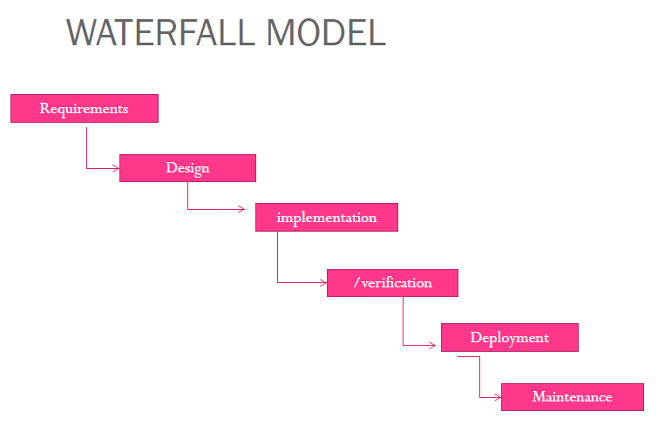

Slide 25
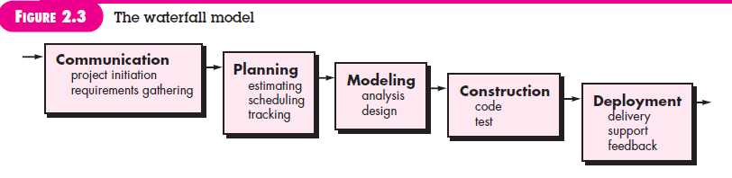

Slide 26
The model can work reasonable well if all the following assumptions are satisfied:
The requirements are precisely known in advance
The requirements include no unresolved high risk items
The requirements won’t change much during development.
The team has previous experience with similar projects so that they know what is involved in building the application.
There is enough time to do everything sequentially.

Slide 27
You can add additional steps or split steps to give more details if you like.
You can also elaborate on a step .
A variation in the representation of the waterfall model is called the V-model.

Slide 28
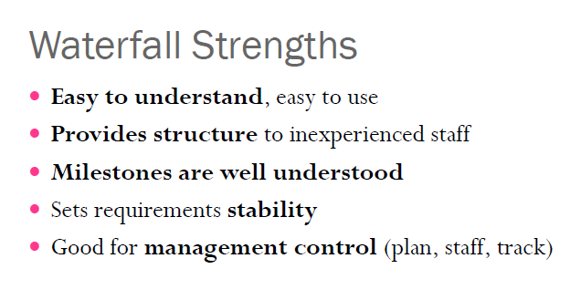

Slide 29
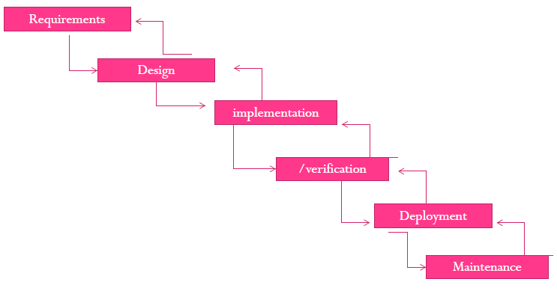
WATERFALL MODEL WITH FEEDBACK

Slide 30
Enables the developer to move backward from one step to the previous step.
If we are working on design and discover that there was a problem in the requirements ,we can briefly go back to the requirements and fix them.
In short, the waterfall model with feedback enables us to move backward from one step to the previous step.

Slide 31
The farther you have to go back up the cascade, the harder it is.
  For example, if we are working on implementation and discover a problem in the requirements, it’s hard to skip back up two stages to fix the problem.
It’s also less meaningful to move back up the cascade for the later steps.
  For example, if we find a problem during maintenance, then we should probably treat it as a maintenance task instead of moving back into the deployment stage.

Slide 32
SASHIMI
Also called sashimi waterfall or waterfall with overlapping phase.
A modified version of the waterfall model.
Is similar to the waterfall except the steps are allowed to overlap.
Introducing feedback into the classical waterfall model.

Slide 33
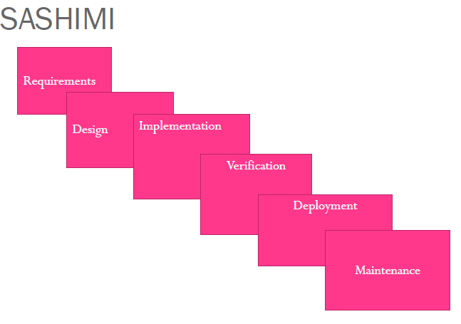

Slide 34
Advantages :-
In a project’s first phase, some requirements will be defined while you are still working on others.
  For example, some of the team members can start designing the defined features while others continue working on the remaining requirements.
You can allow greater overlap between project phases.
  For example, some developers can start writing code for the designed parts of the system while others continue working on the rest of the design tasks, and may be on remaining requirements.

Slide 35
We can allow greater overlap between project phases.
  If we have people working on requirements, design, implementation, testing all at the same time.
  People with different skills can focus on their specialities without waiting for others.
  It lets you perform a spike or deep dive into a particular topic to learn more about it.
It lets later phases modify earlier phases.
  If we discover during design that the requirements are impossible or need alterations, we can make the necessary changes.

Slide 36
  Disadvantage:
  some parts of the application will be more or less finished but the other parts of the system won’t be.

Slide 37
Incremental waterfall
Also called multi-waterfall model.
Uses a series of separate waterfall cascades.
Each cascade ends with the delivery of a usable application called an increment
Each increment includes more features than the previous one.
So in incremental waterfall model we are building the final application incrementally.

Slide 38
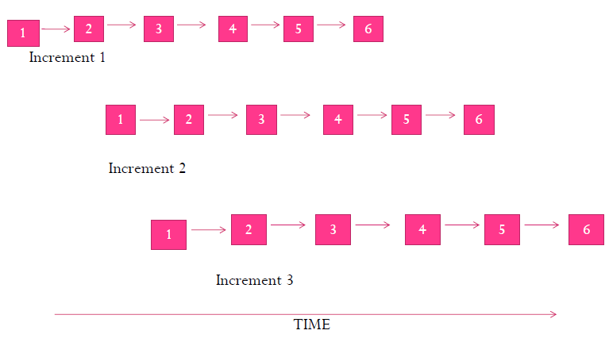
Incremental waterfall

Slide 39
During each increment you will get a better understanding of what the final application should look like.
We learn what did and didn’t work well in the previous increment.
If we understand what we need to do in the next iteration, we don’t need to wait until the current iteration is completely finished.

Slide 40
The incremental waterfall is somewhat adaptive model because its lets you to re-evaluate the direction at the start of each increment.
The incremental waterfall model usually take long time to complete one iteration.
We can change direction when we start a new increment, but within each increment the model runs predictively. In that sense, it is not all that adaptive.

Slide 41
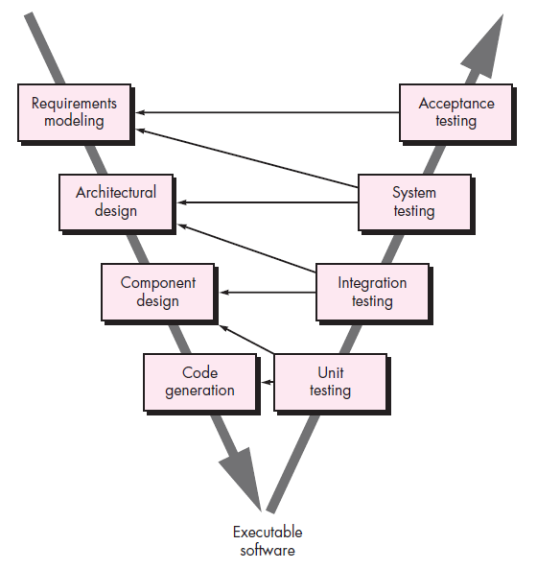
V-Model

Slide 42
Basically a waterfall model that’s been bent into a V-shape Or A variation in the representation of the waterfall model is called the V-model.
As a software team moves down the left side of the V, basic problem requirements are refined into progressively more detailed and technical representations of the problem and its solution.

Slide 43
Once code has been generated, the team moves up the right side of the V, essentially performing a series of tests (quality assurance actions) that validate each of the models created as the team moved down the left side.
The task on the left side of the V break the application down from its highest conceptual level into more and more detailed tasks.
The process of breaking the application down into pieces is called Decomposition.

Slide 44
The tasks on the right side of the V consider the finished application at greater and greater levels of abstraction.
At the lowest level, Testing verifies that the code works.
At the next level, verification confirms that the application satisfies the requirements, and validation confirms that the application meets customer needs.
The process of working backup to the conceptual top of the application is called Integration.

Slide 45
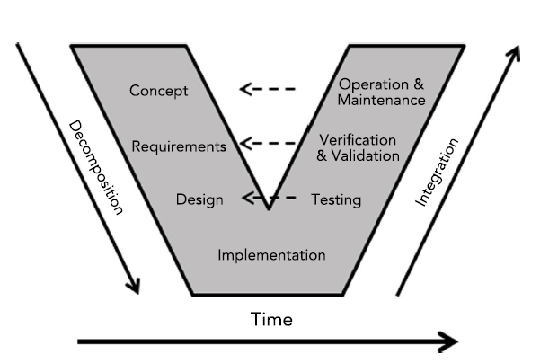

Slide 46
Each of the tasks on the left corresponds to a task on the right with a similar level of abstraction.
At the highest level, the initial concept corresponds to operation and maintenance.
At the next level, the requirements correspond to verification and validation.
Testing confirms that the design worked.

Slide 47
In reality, there is no fundamental difference between the classic life cycle and the V-model.
The V-model provides a way of visualizing how verification and validation actions are applied to earlier engineering work.

Slide 48
Use cases and User stories
A user story and use case are both software development models to describe a user's interaction with the system. Each model is unique and serves a different purpose, though both are used to define user requirements and can be used for verification and validation of the system.
A use case is a detailed, step-by-step description of how a user will interact with the system. It describes the flow of events that a user will experience when performing a task with the system.

Slide 49
A use case should include a list of actors involved, their goals, the steps they take to achieve their goals, the scenarios they may encounter, and any alternative scenarios they may face. Use cases are written from the user's point of view, with the user's goals and objectives in mind.
A user story is a brief statement describing a feature from an end user's perspective. It is used to capture a user's needs and requirements. The standard format for user stories is "As a [role], I desire [objective] so that [benefit]."

Slide 50
As a customer, I want to be able to order products online so that I can comfortably buy from home, for instance. User stories are high-level and often used early in the software development process.
The next difference between use case and user story is the purpose to help provide guidance to software development teams and to help ensure that the product meets the user's needs. Both are ways of looking at the user's needs and the software system being developed.

Slide 51
Use case story is a structured way of capturing the requirements for a system by analyzing how the user interacts with the system to achieve a goal. A use case is a set of scenarios that describes how the user interacts with the system.

